Slide 1
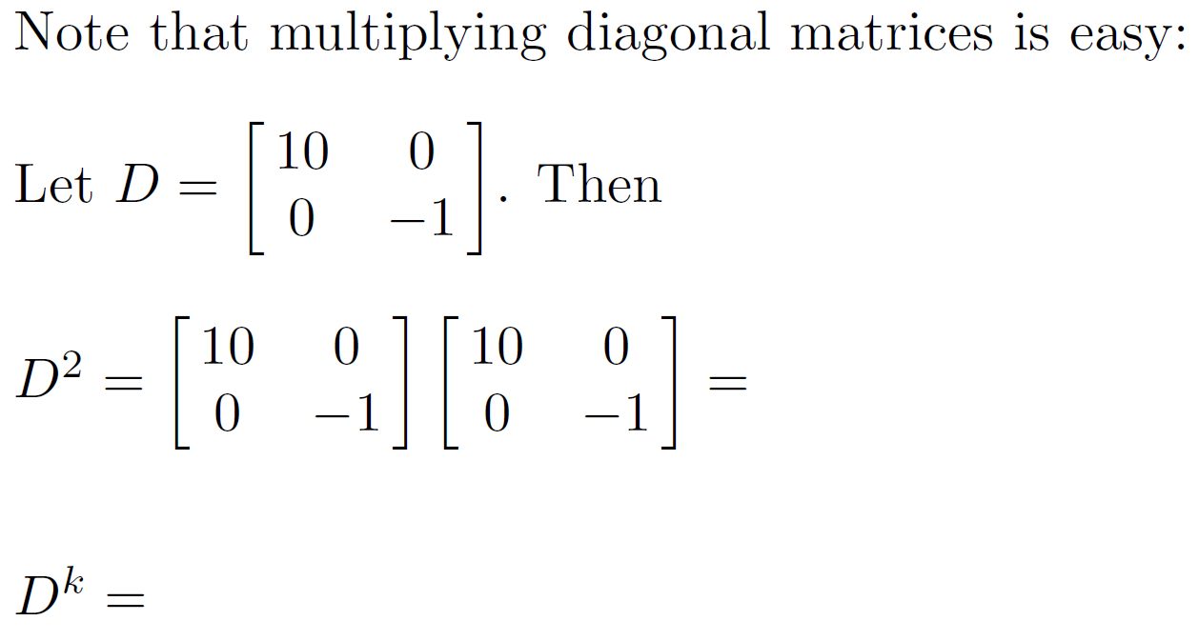

Slide 2
A is diagonalizable if there exists an invertible matrix P such that P⁻¹AP = D where D is a diagonal matrix.
Diagonalization has many important applications
It allows one to convert a more complicated problem into
a simpler problem.
Example: Calculating A^{k} when A is diagonalizable.

Slide 3
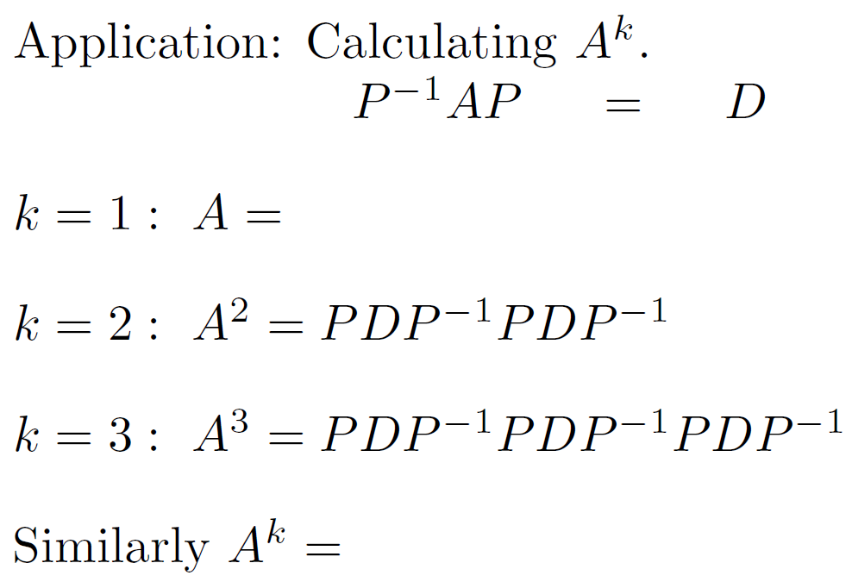

Slide 4

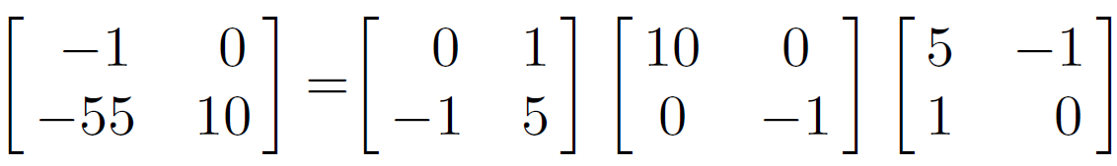
3
3

Slide 5
3
3
3
3
3

Slide 6
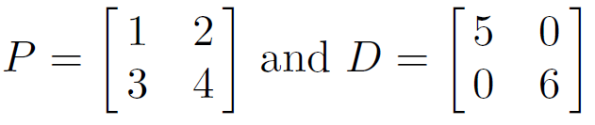



More diagonalization background:
I.e., we are assuming A is diagonalizable since
implies

Slide 7
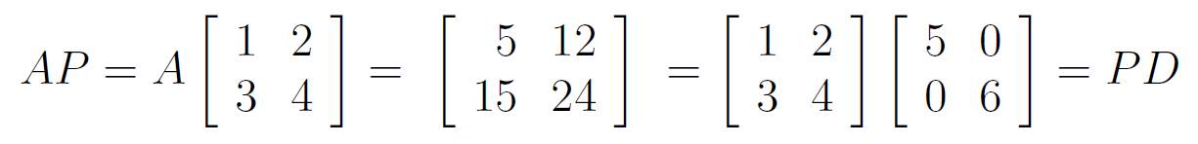

Slide 8
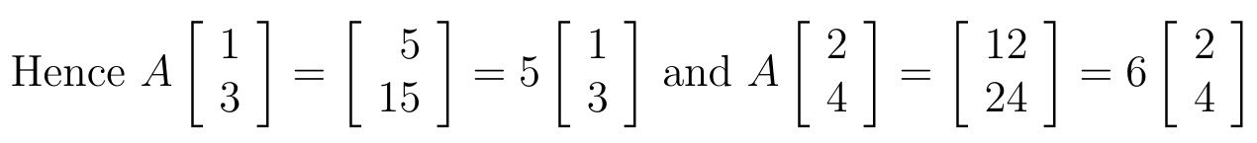

Slide 9
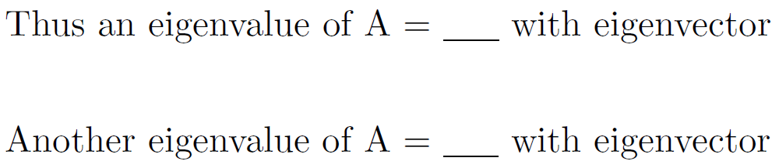

Slide 10
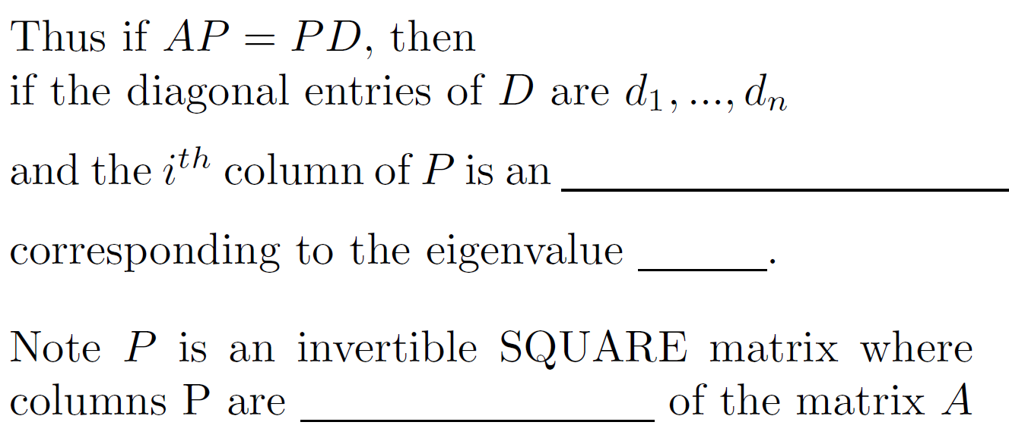

Slide 13
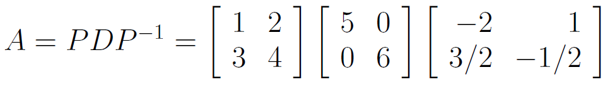

Slide 14
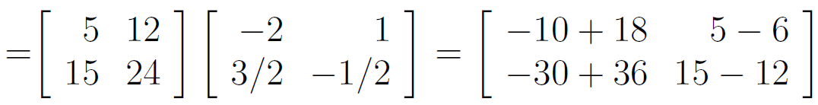
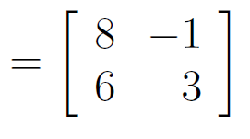

Slide 15
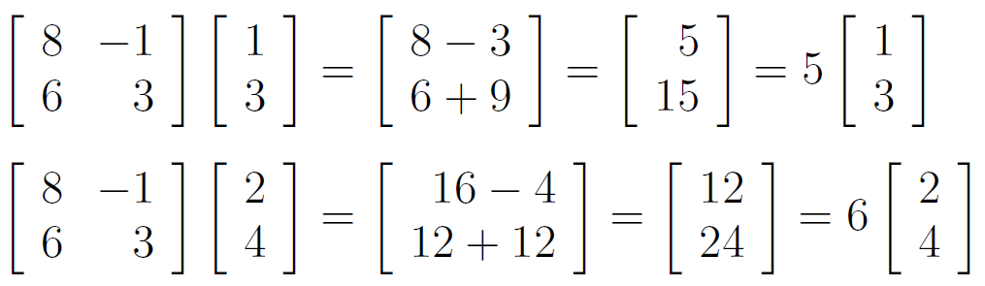
Check answer:

Slide 16
To diagonalize a matrix A:
Step 1: Find eigenvalues: Solve the equation: det (A – λΙ) = 0
for λ.
Step 2: For each eigenvalue, find its corresponding eigenvectors by solving the homogeneous system of equations: (A – λΙ)x = 0
for x.
Case 3a.) IF the geometric multiplicity is LESS then the algebraic multiplicity for at least ONE eigenvalue of A, then A is NOT diagonalizable. (Cannot find square matrix P).
Matrix defective = NOT diagonalizable.

Slide 17
Case 3b.) A is diagonalizable if and only if
geometric multiplicity = algebraic multiplicity
for ALL the eigenvalues of A.
Use the eigenvalues of A to construct the diagonal matrix D
Use the basis of the corresponding eigenspaces for the
corresponding columns of P. (NOTE: P is a SQUARE matrix).
NOTE: ORDER MATTERS.

Slide 18
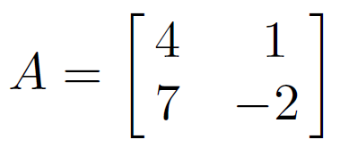
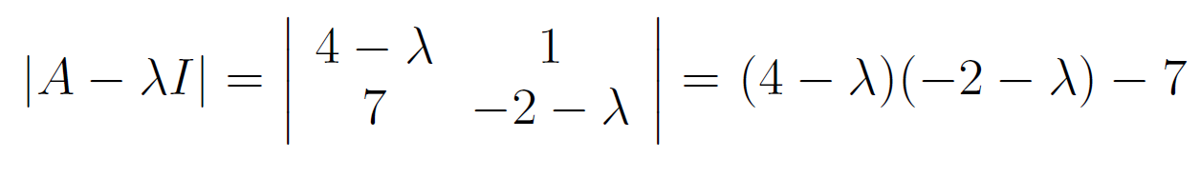

For more complicated example, see video 4: Eigenvalue/Eigenvector Example
& video 5: Diagonalization
Step 1: Find eigenvalues: Solve the equation: det (A – λI) = 0
for λ.

Slide 19
characteristic equation:
λ = -3 : algebraic multiplicity =
geometric multiplicity =
dimension of eigenspace =
λ = 5 : algebraic multiplicity
geometric multiplicity
dimension of eigenspace
1 ≤ geometric multiplicity ≤ algebraic multiplicity

Slide 20
characteristic equation:
λ = -3 : algebraic multiplicity = 1
geometric multiplicity = 1
dimension of eigenspace = 1
λ = 5 : algebraic multiplicity = 1
geometric multiplicity = 1
dimension of eigenspace = 1
1 ≤ geometric multiplicity ≤ algebraic multiplicity
Matrix is not defective.

Slide 21
characteristic equation:
λ = -3 : algebraic multiplicity = 1
geometric multiplicity = 1
dimension of eigenspace = 1
λ = 5 : algebraic multiplicity = 1
geometric multiplicity = 1
dimension of eigenspace = 1
1 ≤ geometric multiplicity ≤ algebraic multiplicity
Matrix is not defective.
Thus A is diagonalizable

Slide 22
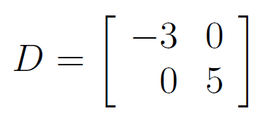
characteristic equation:
λ = -3 : algebraic multiplicity = 1
geometric multiplicity = 1
dimension of eigenspace = 1
λ = 5 : algebraic multiplicity = 1
geometric multiplicity = 1
dimension of eigenspace = 1
1 ≤ geometric multiplicity ≤ algebraic multiplicity
Matrix is not defective.
Thus A is diagonalizable

Slide 23
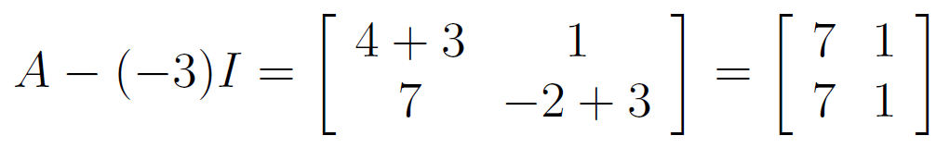
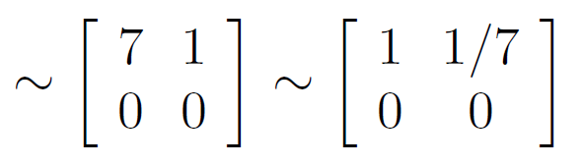
Find eigenvectors to create P
Nul(A + 3Ι) = eigenspace corresponding to eigenvalue λ = -3 of A

Slide 24
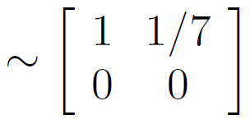

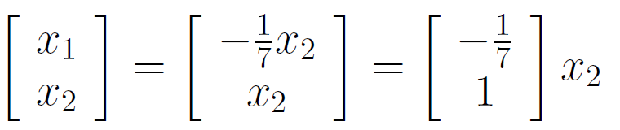

Slide 25
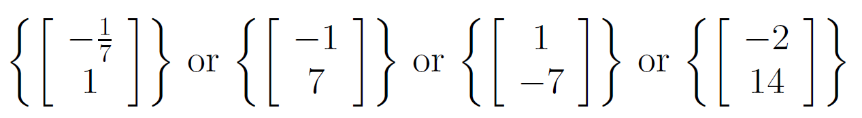
Basis for eigenspace corresponding to λ = -3:

Slide 26
Basis for eigenspace corresponding to λ = -3:

Slide 27
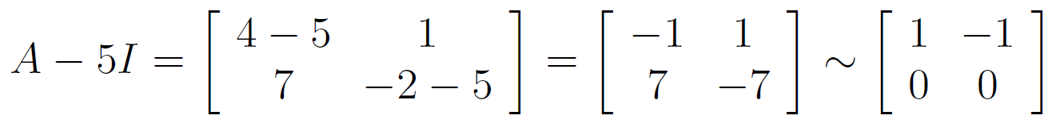
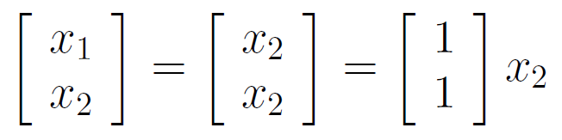
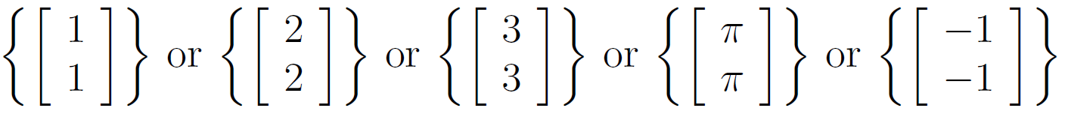
Find eigenvectors to create P
Nul(A - 5Ι) = eigenspace corresponding to eigenvalue λ = 5 of A
Basis for eigenspace corresponding to λ = 5:

Slide 28
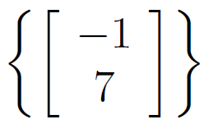
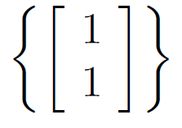
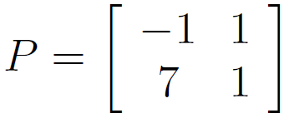
Basis for eigenspace corresponding to λ = -3:
Basis for eigenspace corresponding to λ = 5:

Slide 29
Basis for eigenspace corresponding to λ = -3:
Basis for eigenspace corresponding to λ = 5:

Slide 30
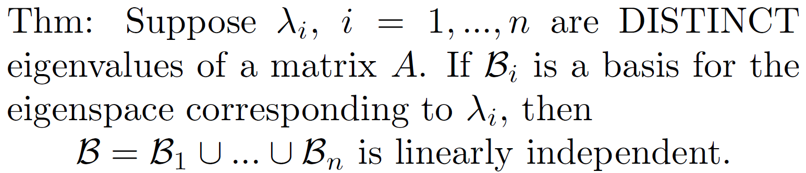
Note we want to be invertible.
Note P is invertible if and only if
the columns of P are linearly independent.
We get this for FREE!!!!!

Slide 31
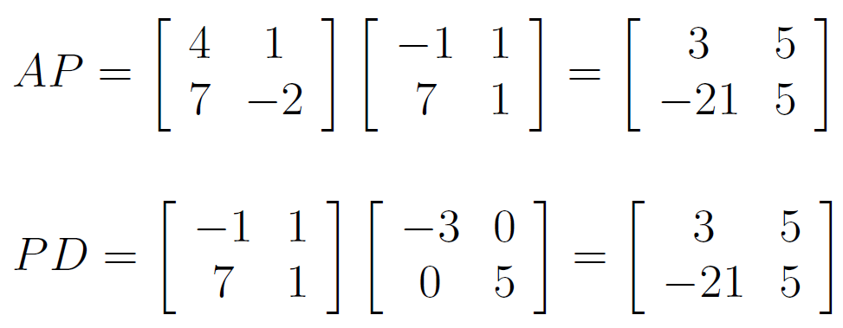
Note: You can easily check your answer.

Slide 32
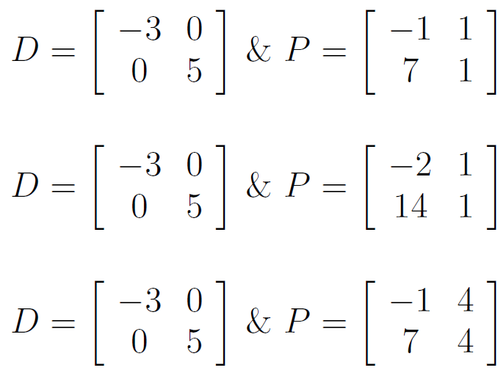
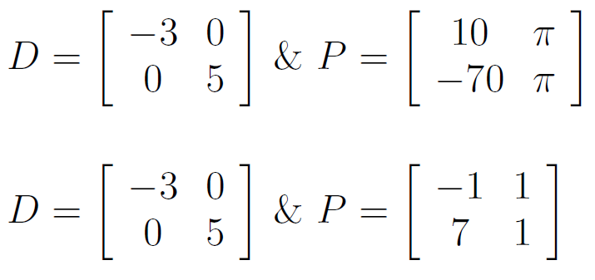
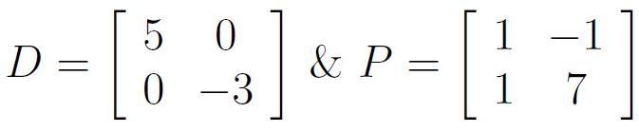
Note there are many correct answers.
Diagonalize

Slide 33
Note there are many correct answers.
Diagonalize
ORDER MATTERS!!!

